Slide 1
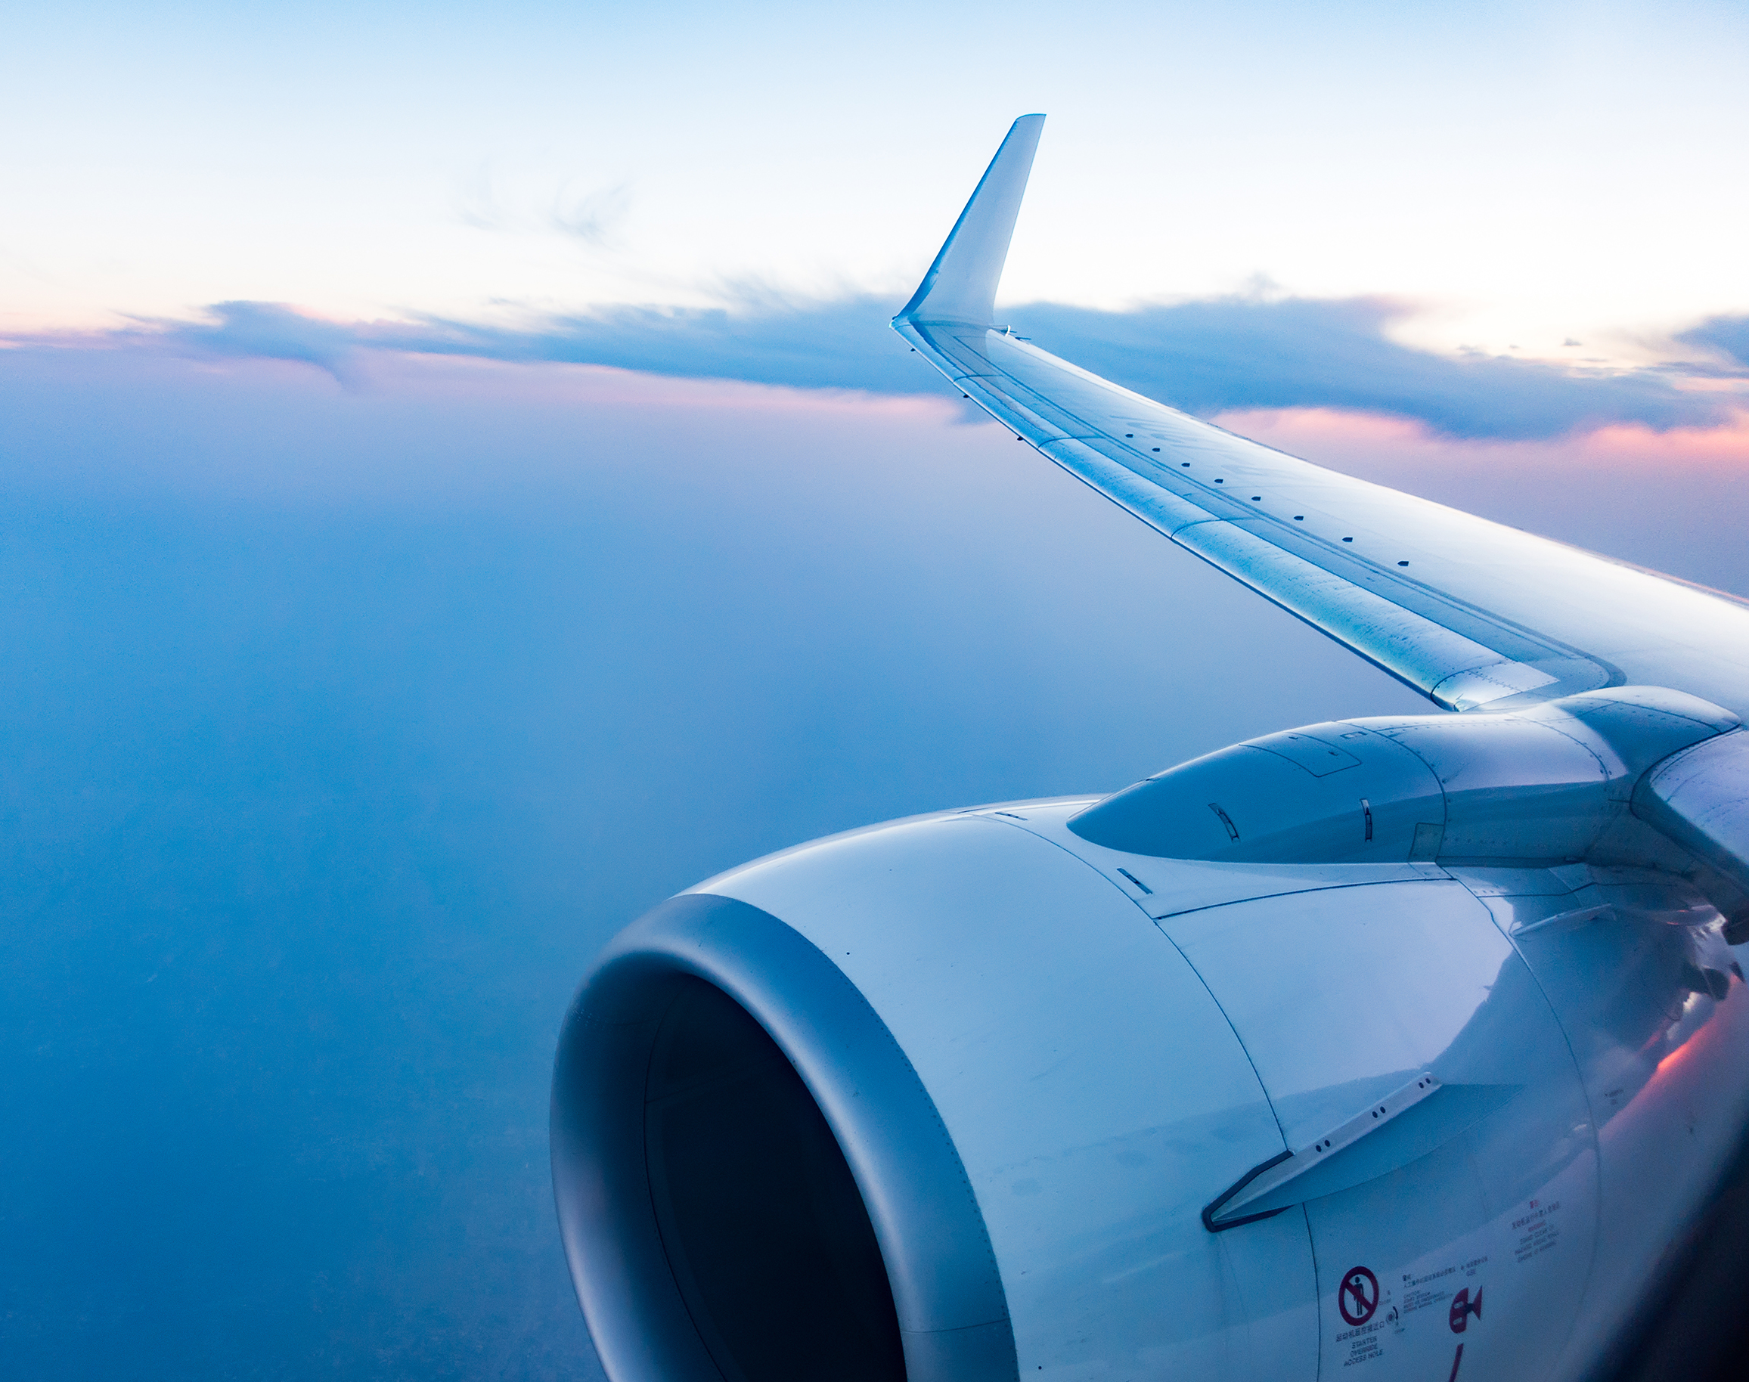
Flight Ticket Reservations Database
Sonpaorong Muchhim & Htoo Myat Maung

Slide 2
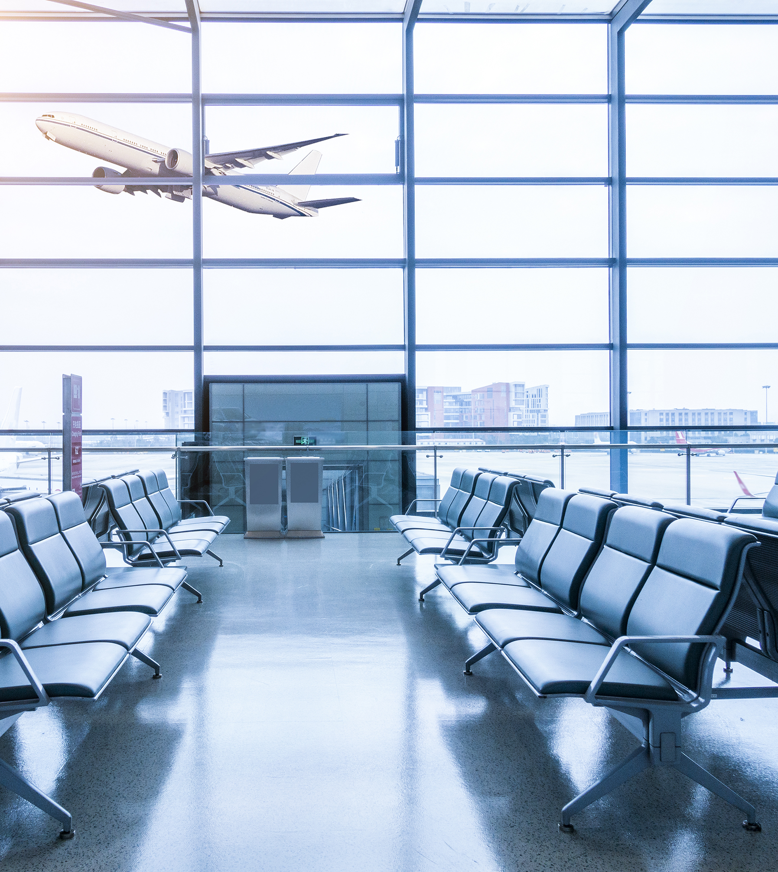
Flight Ticket Reservation
The Flight Ticket Reservation Database is designed to facilitate the efficient management of flight ticket reservations, encompassing various entities and their relationships. The essential entities in this database include the customer information, operated airline, airport information, ticket detail, flight detail, payment for ticket, and class of each flight entities. These entities along with their specific relationship plays an important role for functionality of flight ticket reservations database.

Slide 3
Entities Attribute
Customer Information
Ticket Information
Flight Detail
Airline
Airport
Customer ID​
First Name​
Last Name​
Gender​
DOB​
Contact Information​
Email​
Passport​
Ticket Number
Customer ID
Flight Number
Class ID
Seat Number
Reservation Date
Reservation Time
Flight Number
Airline ID
Departure Airport
Arrival Airport
Departure Date
Arrival Date
Departure Time
Arrival Time
Duration
Gate
Terminal
Flight Status
Airline ID
Airline Name
Contact Info
Email
Airline ID
Airline Name
Contact Info
Email
​
Payment
Class
Payment ID
Ticket Number
Amount
Date
Time
Method
Class ID
Class Name
Capacity
Flight Number

Slide 4
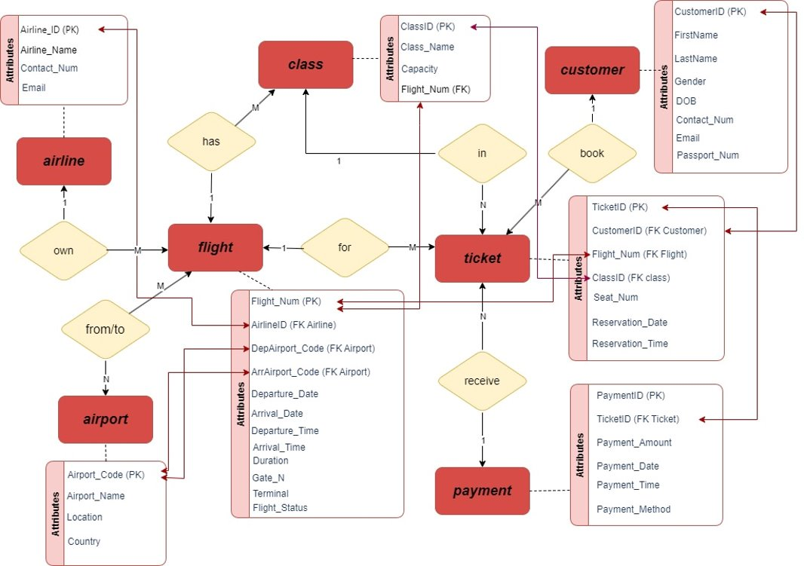
ER-Diagram

Slide 5
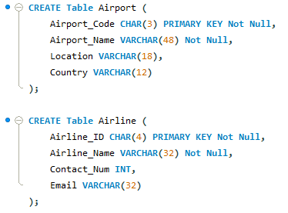
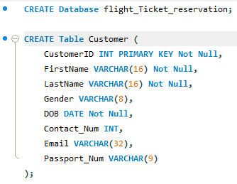
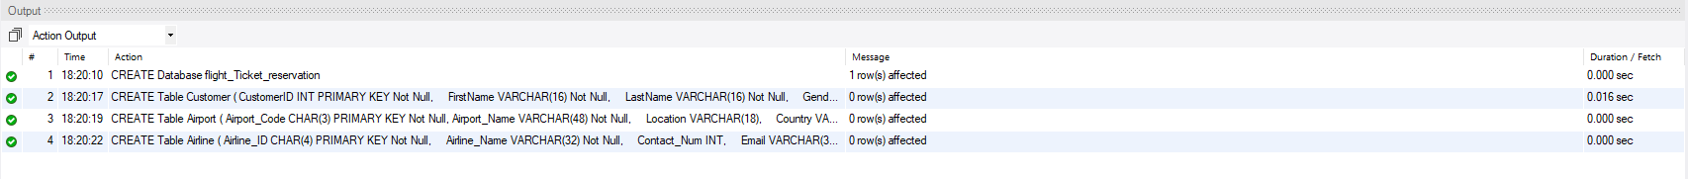
Database & Tables Queries

Slide 6

Questions
What are some payment information of John Doe such as the amount he spent, payment date, payment time and payment method?
What is the flight information in June 2023?
How many available ticket in Business class of Flight 106?
What are all the passenger information on flight number 106?
Update the necessary information about flight 103 such as Flight Status and Time due to 30 minutes delay.
What are all the code which represents airport or airline?
Which flight has economy price ticket higher than business class from other flight ?
What is the total revenue generated from Flight 104?
Delete the information about Flight 101, and the other information that refers to it.

Slide 7
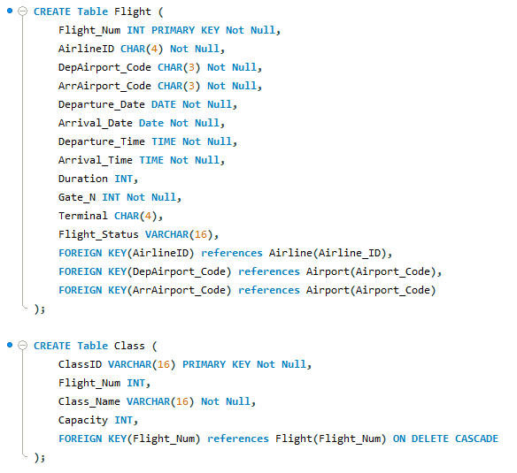
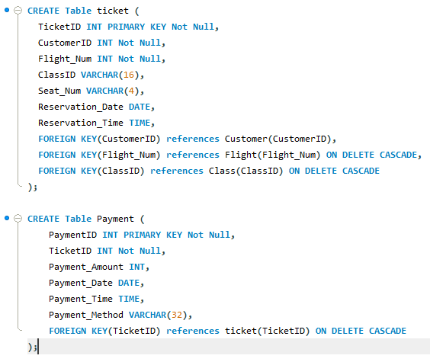
Tables Queries

Slide 8
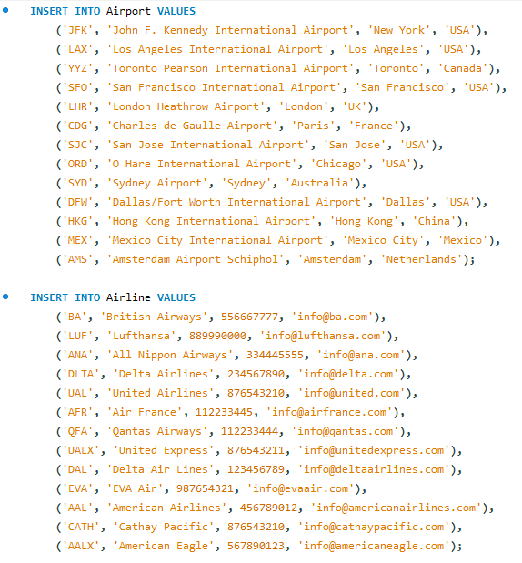
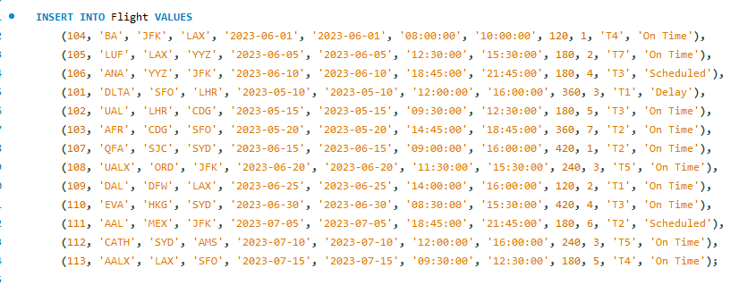
Insert Data

Slide 9
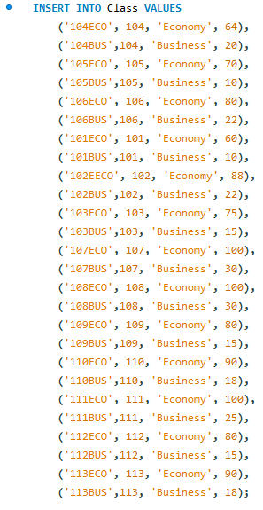
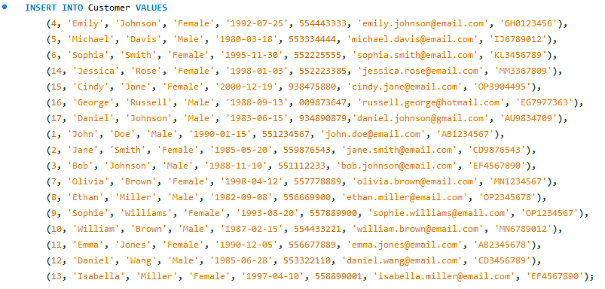
Insert Data

Slide 10
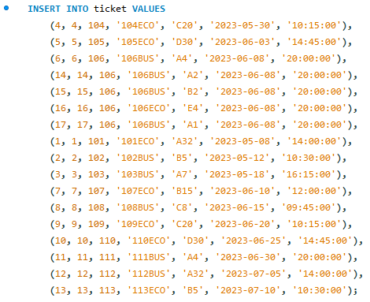
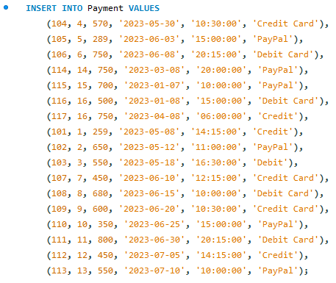
Insert Data

Slide 11
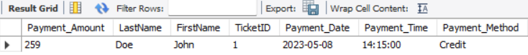
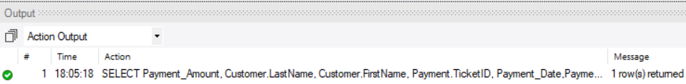
1.What are some payment information of John Doe such as the amount spent, payment date, payment time and payment method?

Slide 12
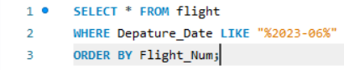
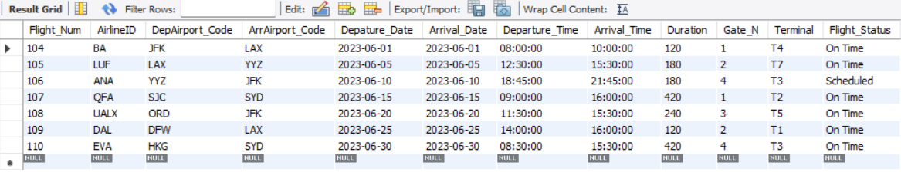
2. What is the flight information in June 2023?

Slide 13

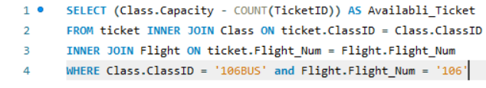
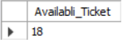
3. How many available ticket in Business class of Flight 106?

Slide 14
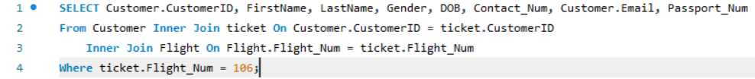
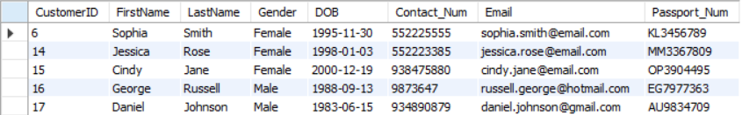
4. What are all the passenger information on flight number 106?

Slide 15
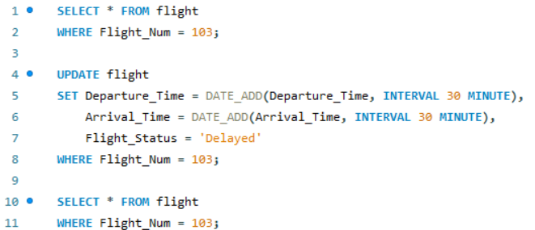
5. Update the necessary information about flight 103 such as Flight Status and Time due to 30 minutes delay.
Before:
After:

Slide 16
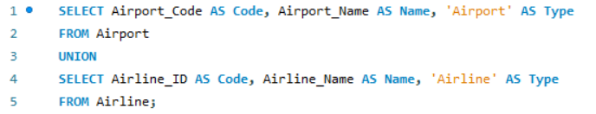
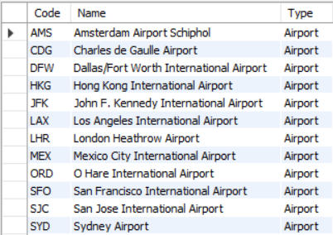
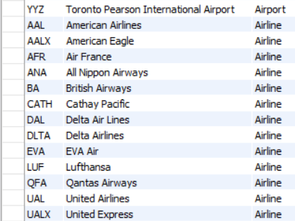
6. What are all the code which represents airport or airline?

Slide 17
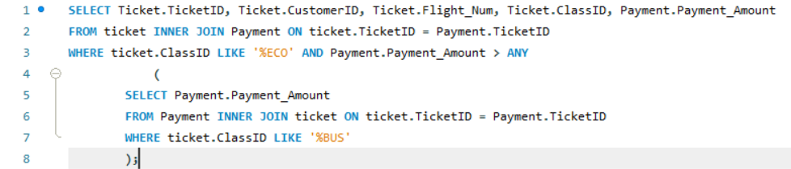
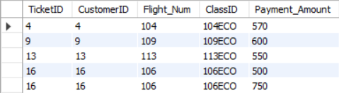
7. Which flight has economy price ticket higher than business class from other flight ?

Slide 18
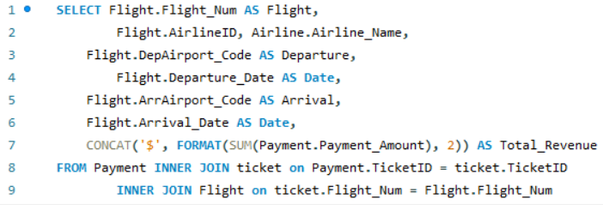
8. What is the total revenue generated from Flight 104?

Slide 19
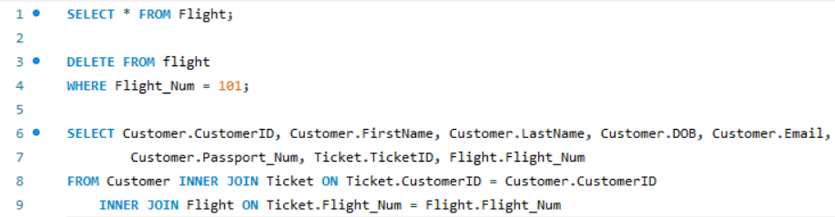
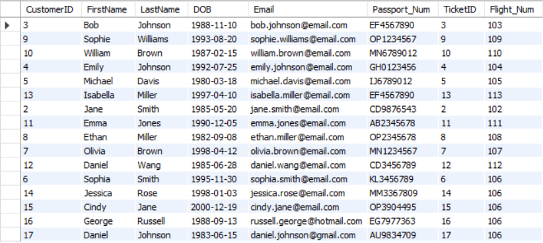
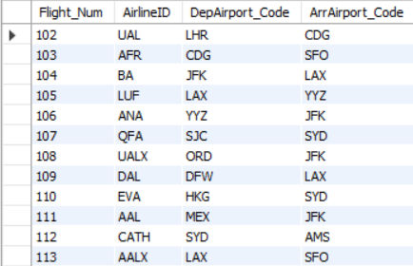
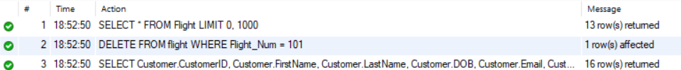
9. Delete the information about Flight 101, and the other information that refers to it.

Slide 20

Thank You!!

